Slide 1
CPAD Report
Maintenance Group
4/22/2024

Slide 2
Maintenance Group Accomplishments
Mowing
  Walk behind and riding lawnmowers
    Fencelines, ditches, edge of taxiway and runway around lights,
  Strip between residents back fences and airport fence mowed (2 of 3)
  Tractor mowing acreage - both sides airstrip, south over-run area
Weeding around lights, wind tee
Gate repair - north gate stays on track now with larger wheel on one side
Spraying runway edges
Pavement repair airpark

Slide 3
Work Party Participants
Dominic on the Big Tractor
Mike Tillison on the riding lawn mower
Marion Janik , Mark Eagar, and PJ Jensen on the walk behind mowers
Greg Wright on the tow behind weed sprayer
Marion and Mike T. on the north gate wheel repair
Thanks to all who helped

Slide 4
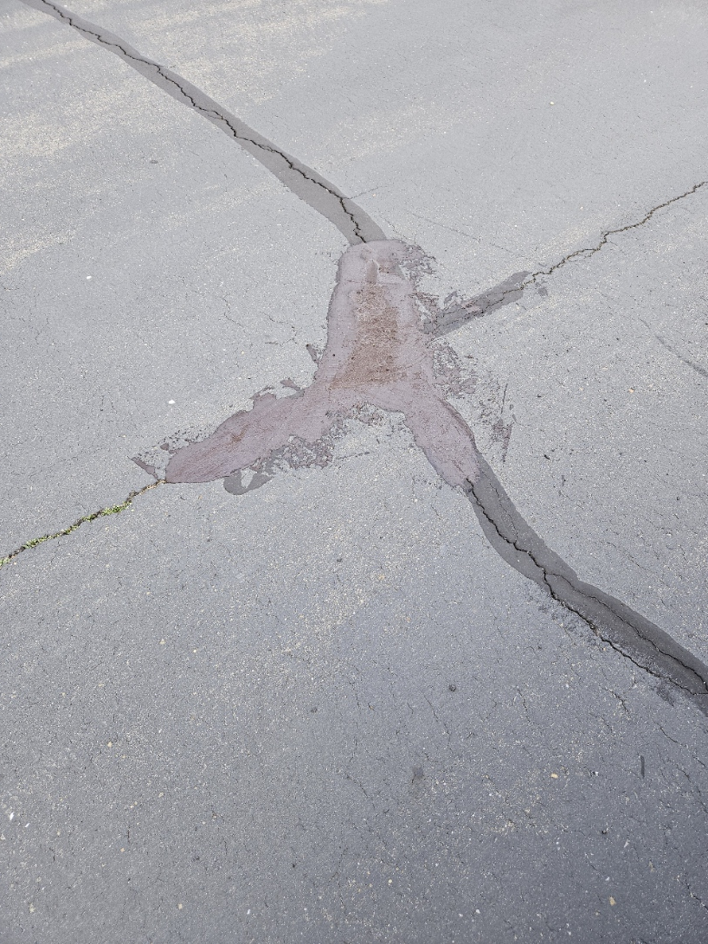
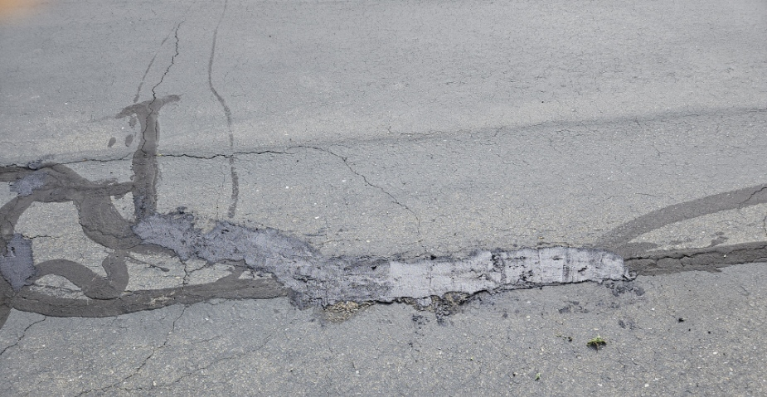
Pavement Repair – Airpark Streets
Chose 2 worst spots for practice repair
Two repair materials used

Slide 5
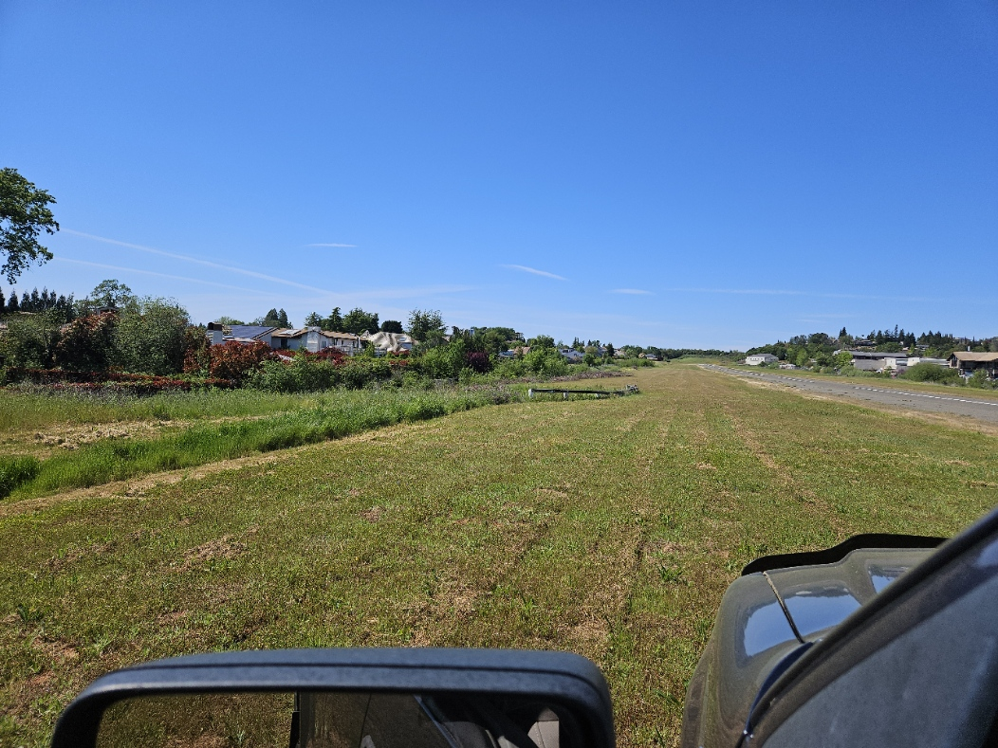

Slide 6
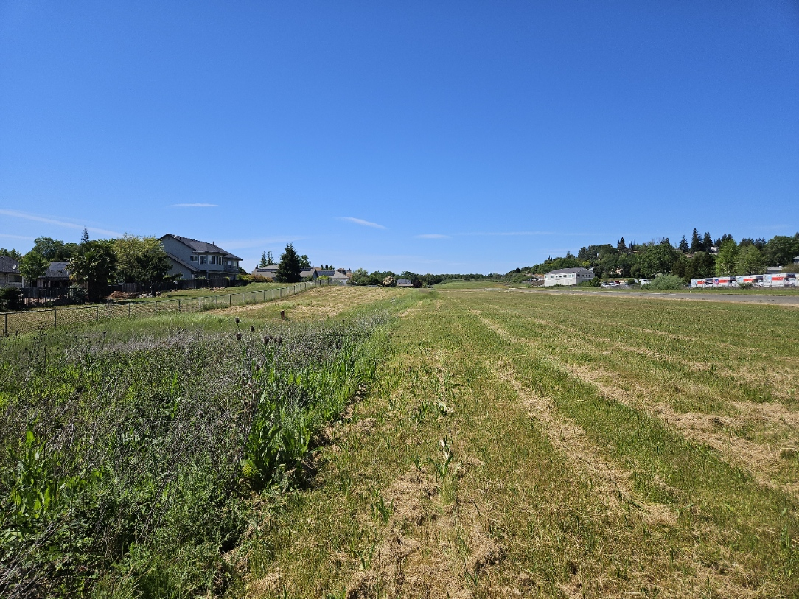

Slide 7
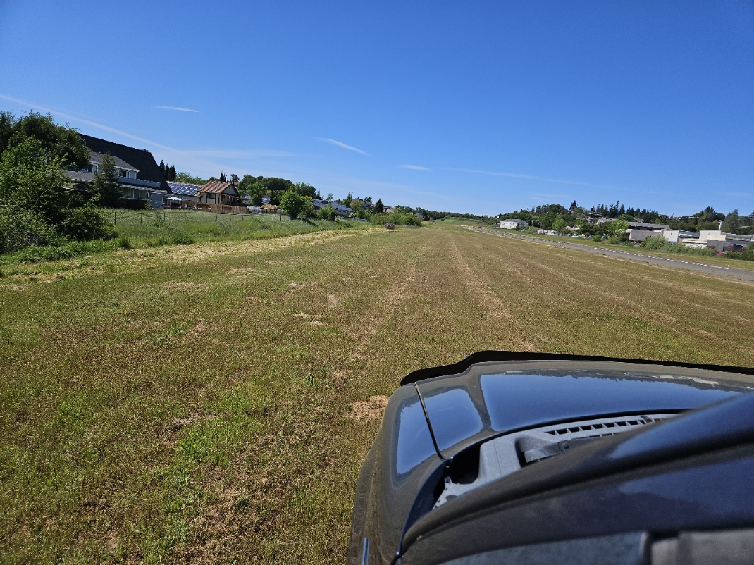

Slide 8
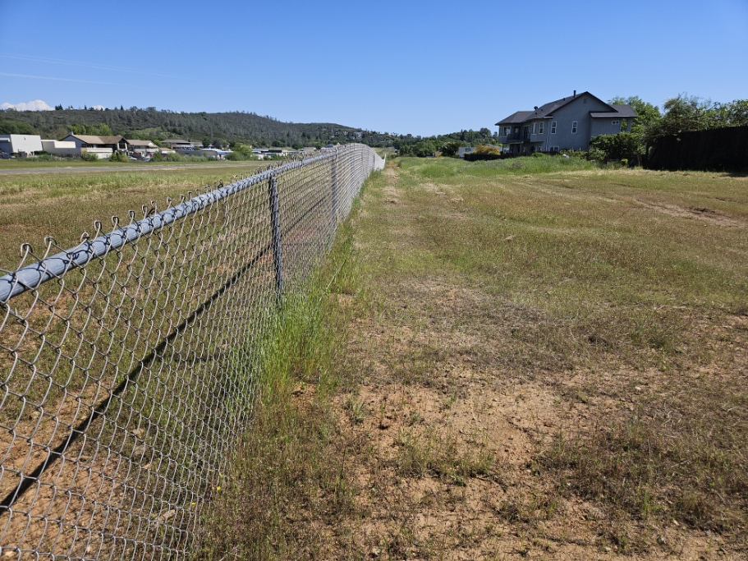

Slide 9
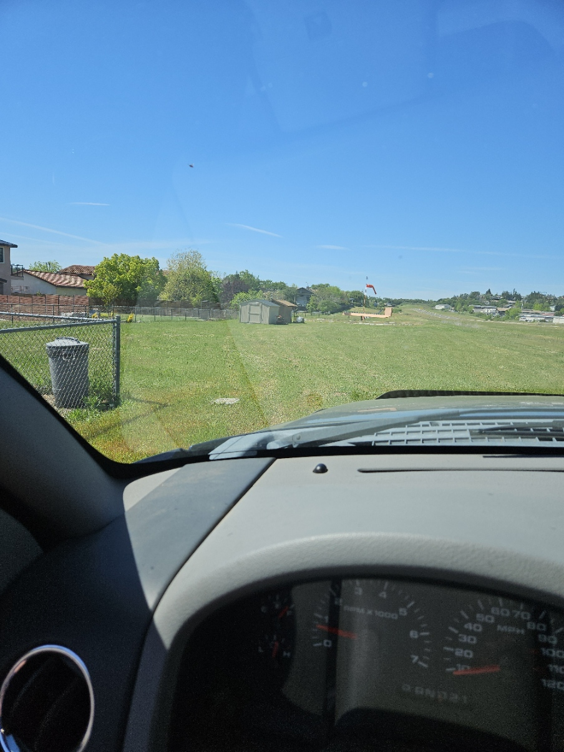
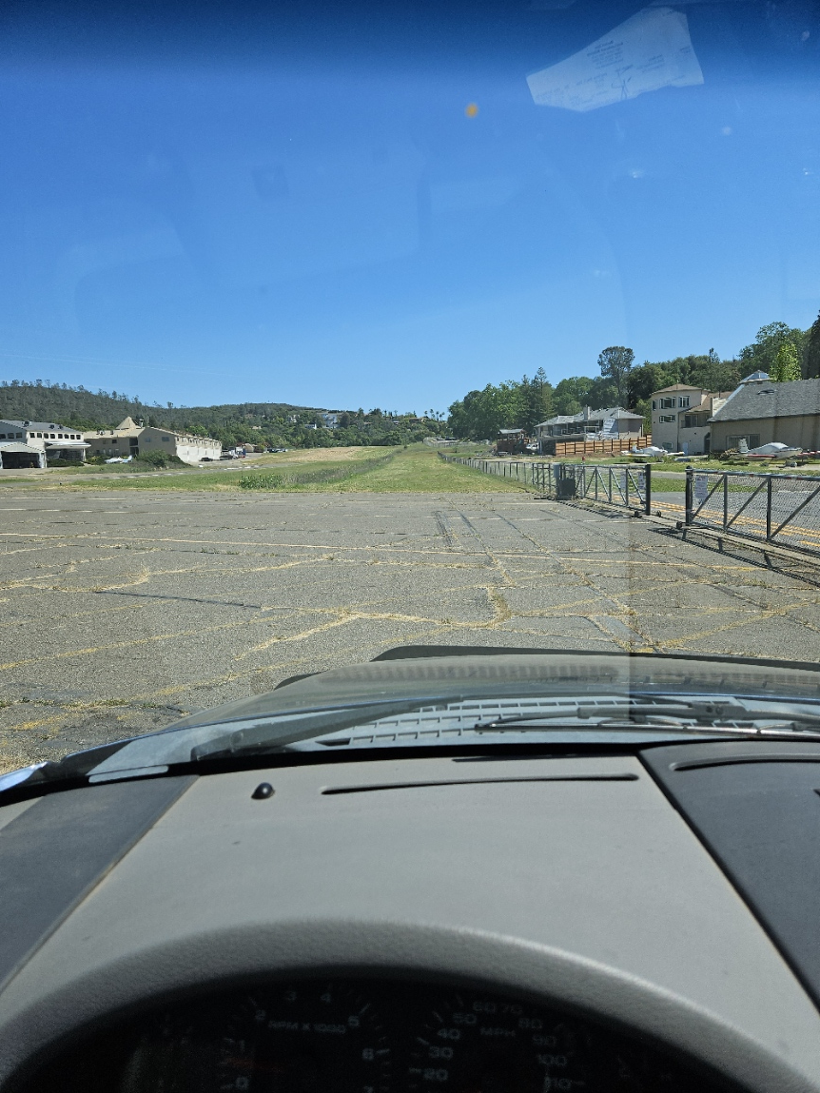
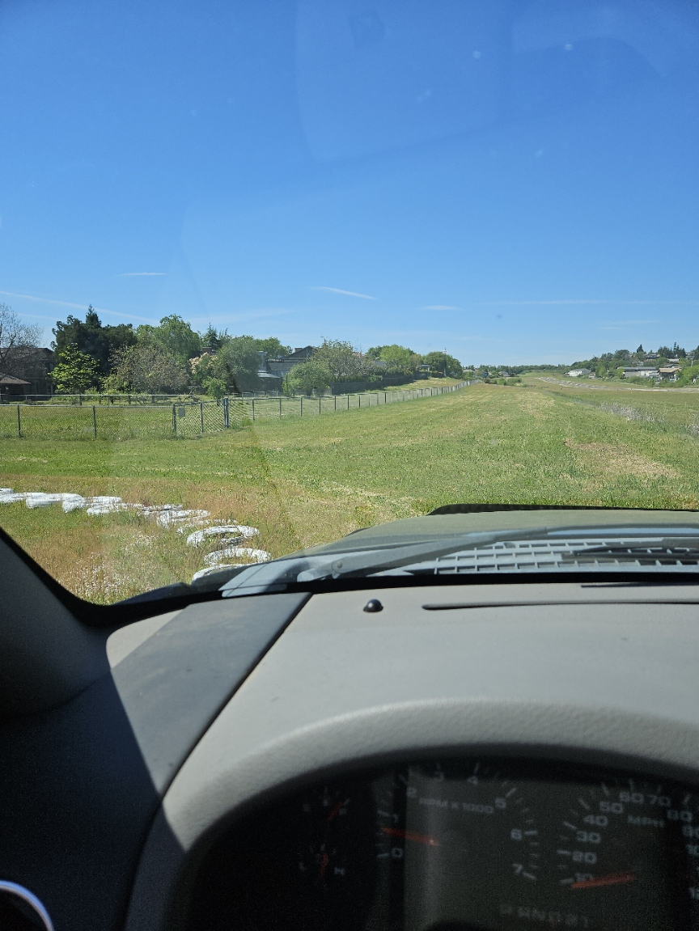
Mowing:

Slide 10
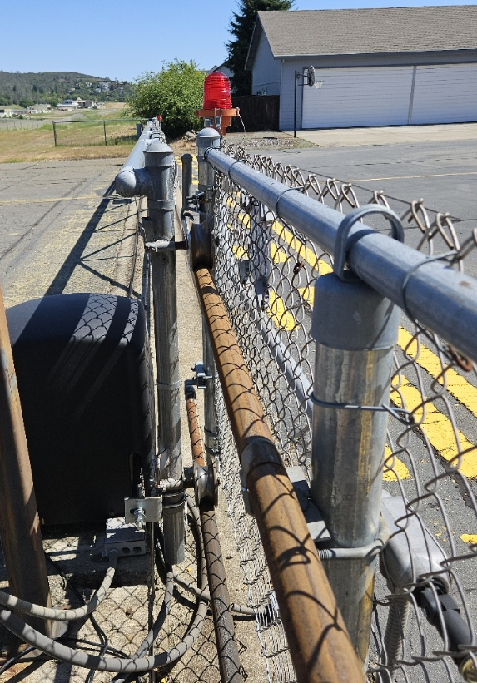
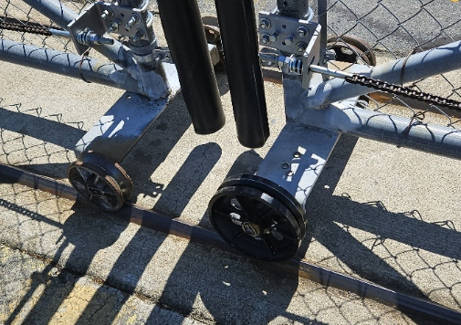
North Gate Repair

Slide 11
Equipment Repairs and Purchase
Repaired walk behind mower (voltage regulator)
Swisher mower repair in work - new throttle cable, air cleaner cover, battery cable
Purchased tow behind spreader for application of emergent weed control
Refurbished tow behind sprayer

Slide 12
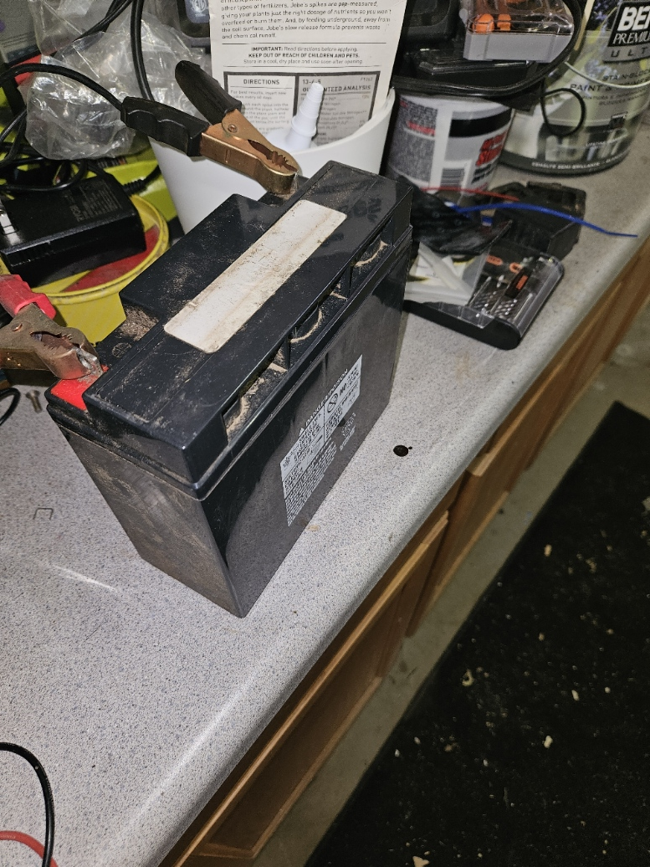
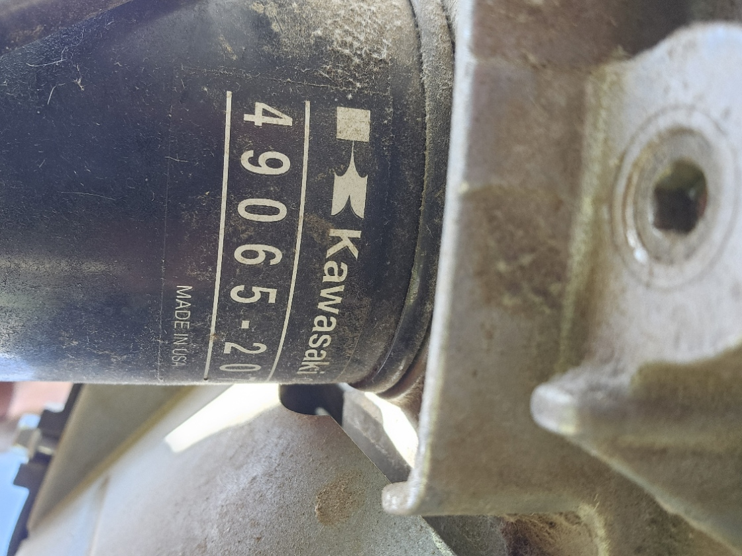
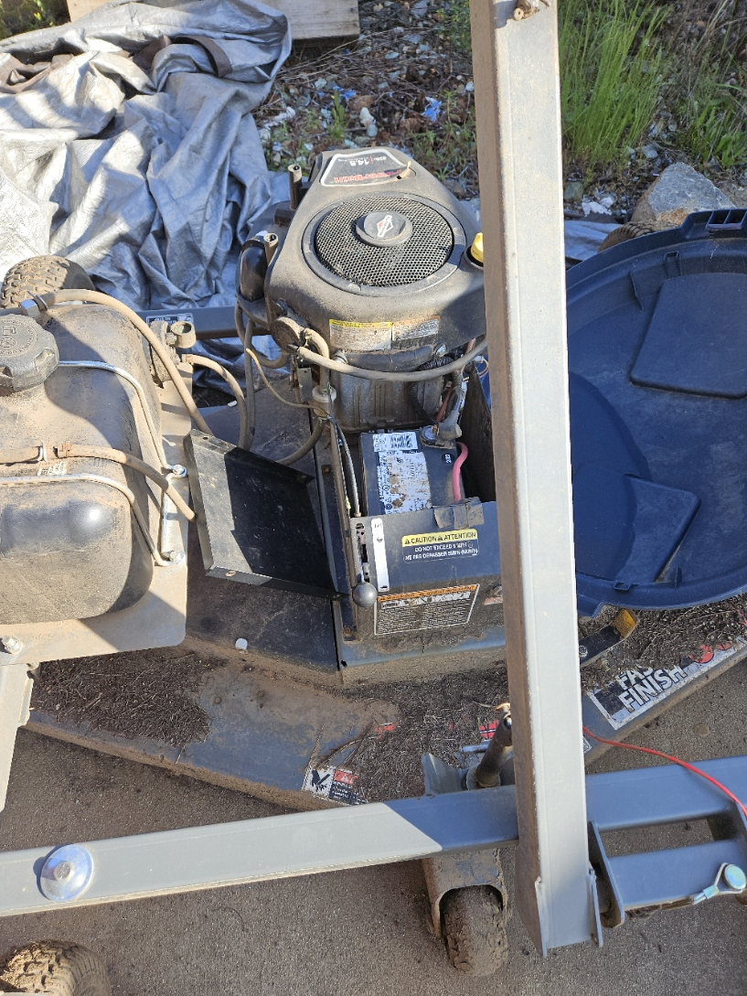
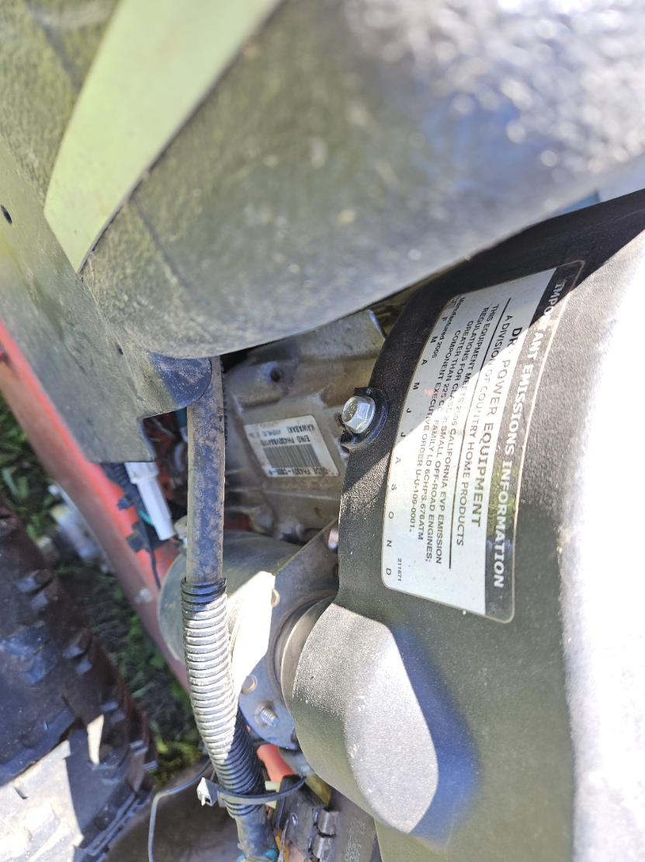
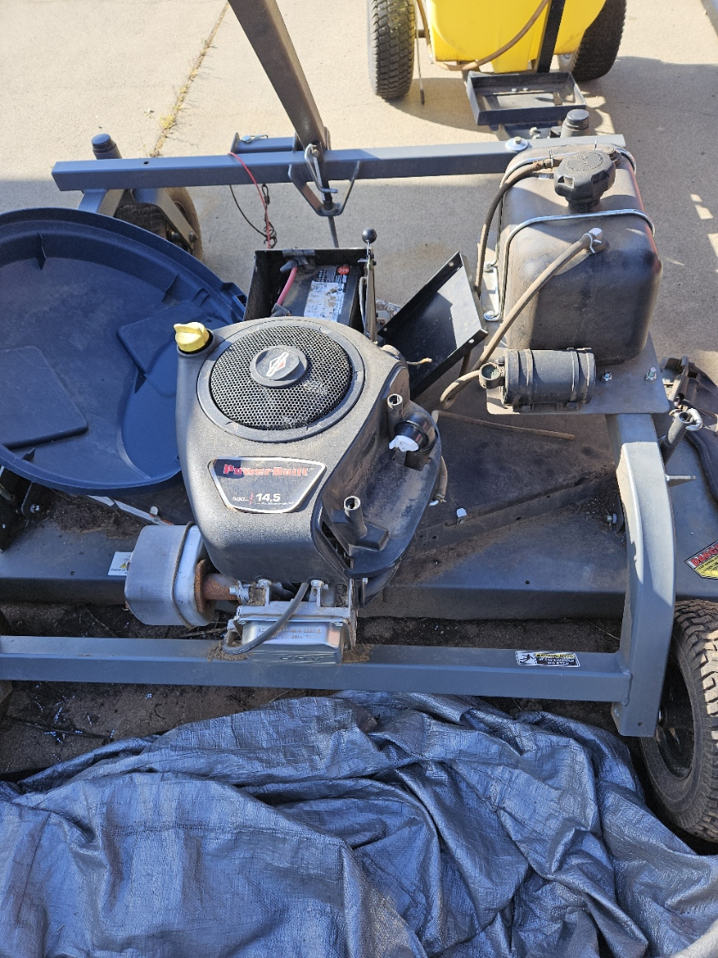
Oil filters, voltage regulator, spreader

Slide 13
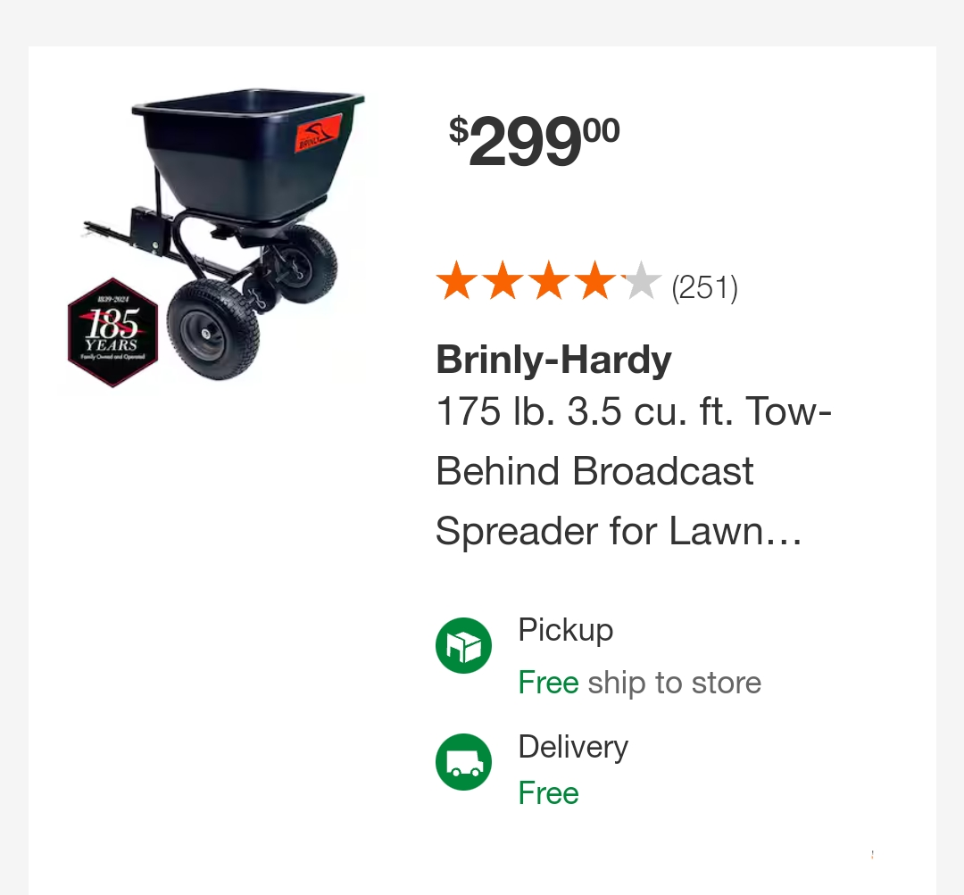
New spreader purchased
Tow behind
Also purchased emergent weed killer

Slide 14
Maintenance Next Projects
Perimeter mowing completed
Spray perimeter
Spray wind tee and weed inside tires
Make a plan for the overgrowth along west side fence
Haul away cut brush along creek
Sharpen blades on both walk behind mowers
Trim blackberry bushes at airport entrance
Weed eat around office and airport entrance
Patch additional airpark and airport rough spots

Slide 15
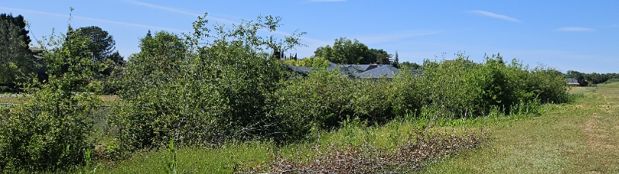
Brush needing cutting

Slide 16
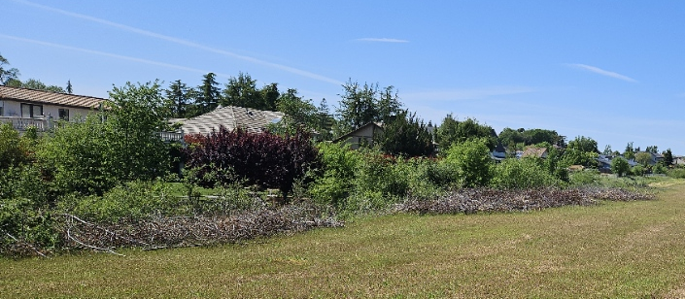
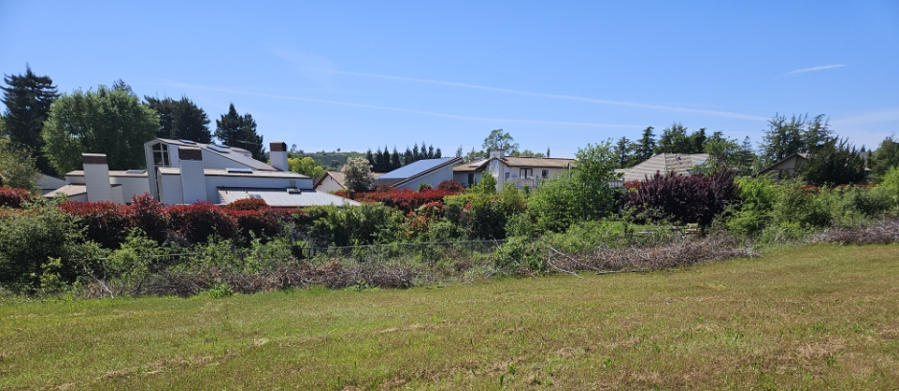
Cut Brush needing removal

